Slide 1
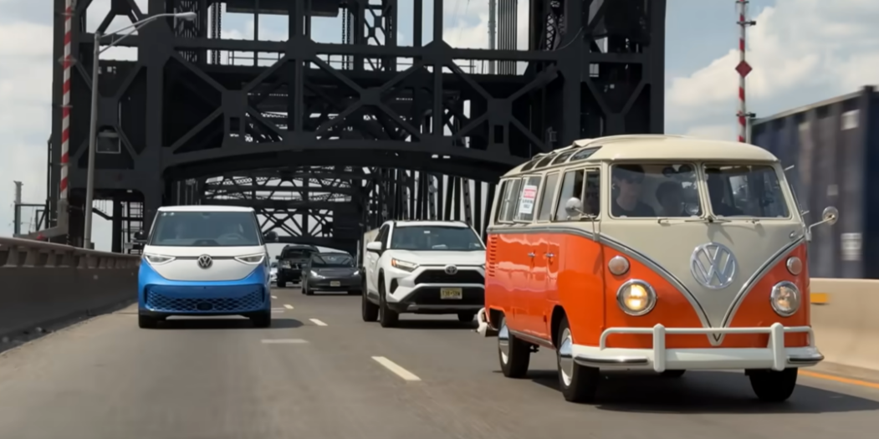
Revolutionizing EV Efficiency and Sustainability Strategic Objectives:
Generative AI for Predictive Battery Cooling:
Predicts cooling needs based on real-time route and
environmental conditions.
Dynamically adjusts the cooling system to maximize
energy efficiency.
Reinforcement Learning for Battery Consumption: Optimizes battery usage based on the route and driving conditions.
Learns from vehicle performance to balance energy
consumption and driving range.
Graph Neural Networks for Motor Optimization: Analyzes route data to optimize motor speed and torque. Minimizes energy loss during complex driving scenarios like uphill climbs.
Route-Based Real-Time Adjustments:
Predicts traffic, terrain, and weather to adjust vehicle
performance dynamically.
Reduces overheating and improves battery life based on
real-time driving inputs.
Dynamic EV Motor Efficiency Management:
Manages motor power distribution to ensure optimal
efficiency and minimal energy waste.
"BEAM" – Battery Efficiency and AI Motor Optimization

Slide 2
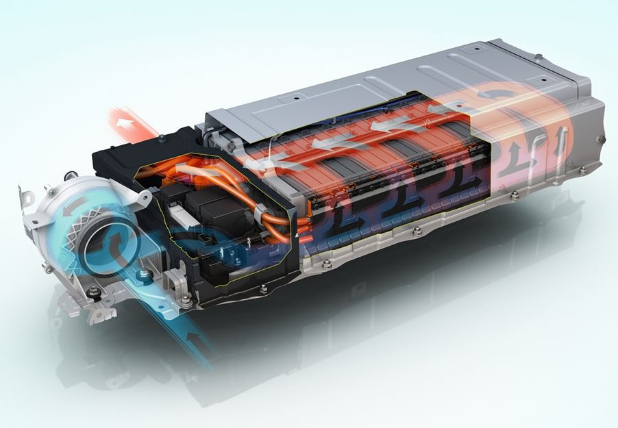
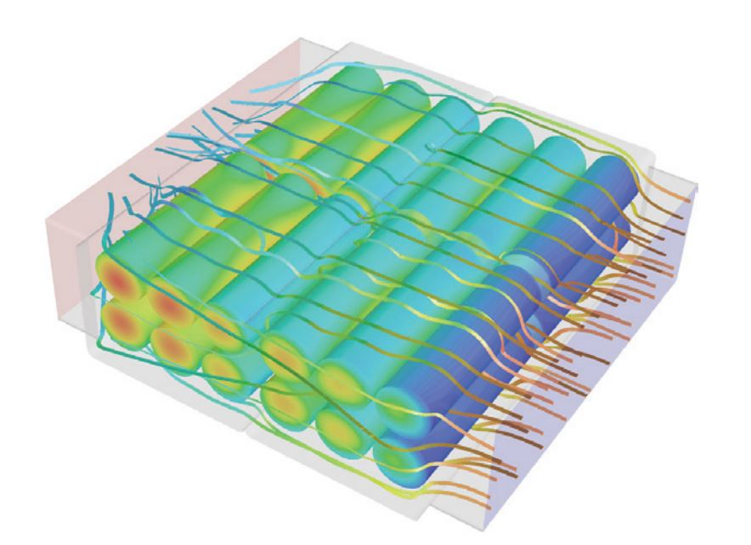
Business Impact and ROI Key Benefits:
Extended Battery Lifespan: Significant reduction in battery replacement costs by prevents overheating and overcooling, extending the battery's lifespan.
Improved Vehicle Range: Increased operational efficiency translates into greater travel distance per charge, reducing the need for frequent charging stops. Optimized power usage and route planning ensure longer trips on a single charge.
Cost Savings: Optimized energy consumption results in lower overall energy costs for fleet operations.
Sustainability Goals: The solution supports corporate sustainability objectives by reducing emissions and promoting energy-efficient practices.
Scalability and Innovation: Scalable across electric vehicle fleets, leveraging real-time AI insights to continuously improve performance and ROI.
Optimized Power Distribution for Motors: Efficient motor management increases vehicle performance and energy savings.
Minimized Energy Waste and Environmental Impact: Dynamic adjustments to motor and battery usage reduce the vehicle's carbon footprint.
Real-Time Adaptation to Route and Traffic Conditions: Continual optimization throughout the trip based on road and traffic patterns.

